Slide 1



Operating System (203105203)
Prof. Umang panchal, Prof Atul Kumar Assistant Professor
Computer Engineering

Slide 2


CHAPTER-3
Inter-Process Communication

Slide 3
Topics
Critical Section
Race Conditions
Mutual Exclusion
Hardware Solution.
Strict Alternation.
Peterso’s Solution,
The Producer\Consumer Problem
Semaphores
Event Counters.
Monitors.
Classical IPC Problems: Readers & Writer Problem.
Dinning Philosopher Problem

Slide 4
Introduction To IPC
IPC refers to a mechanism which allows communication between two or more processes to perform their actions simultaneously.
Processes that are executing concurrently in a program are of two types-
(i) Independent Processes:-These are those processes which does not dependent on execution of other process in same program. Independent processes don’t share data with another process.
(ii) Co-operating Processes:- These are the processes which can affect or get affected by other processes during execution. Co-operating processes can share data with another processes in simultaneous execution.

Slide 5
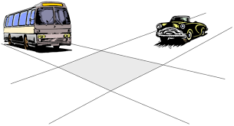

Slide 6
Why we need IPC?
There are several reasons which allows processes to co-operate:-
(i) Information sharing
(ii) Computation speedup
(iii) Modularity
(iv) Convenience

Slide 7
Race condition
Race condition is a situation arise due to concurrent execution of more than one processes which are accessing and manipulating the same shared data and the result of execution depends upon the specific order where the access take place.
Race condition leads to inconsistency which is totally undesirable.
Reasons for Race Condition
1. Exact instruction execution order cannot be predicted
2. Resource (file, memory, data etc…) sharing.

Slide 8
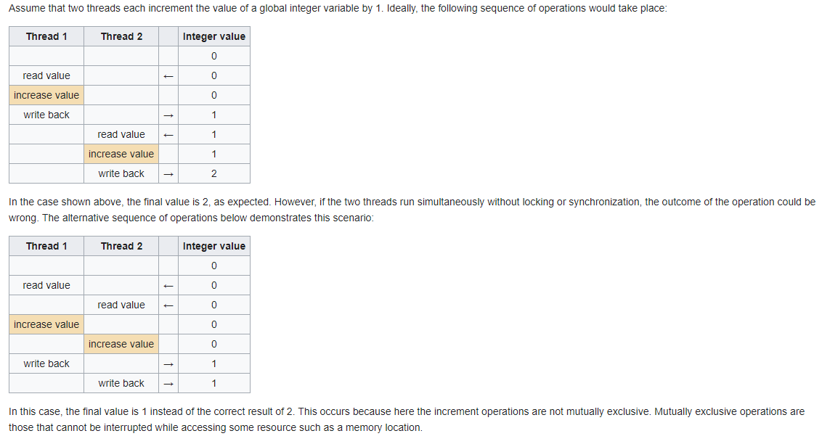
Example of race condition

Slide 9
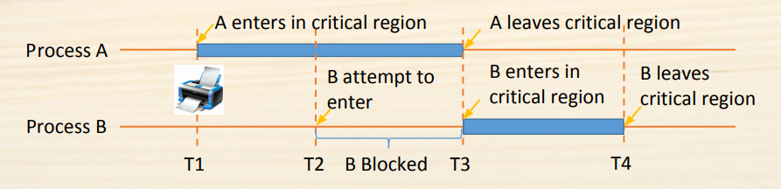
Critical section
Critical section is piece of code which contains some shared code of variable which is accessible by each process concurrently in order to complete execution. There must be only one process is allowed at a time in critical section otherwise more than one access may lead to inconsistency. concurrent accesses to shared resources can lead to unexpected or erroneous behaviour , so part
of the program where the shared resource is accessed is protected. This protected section is the critical section or critical region.
Figure :1 [image source google ]

Slide 10
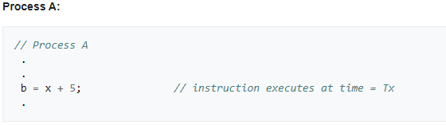
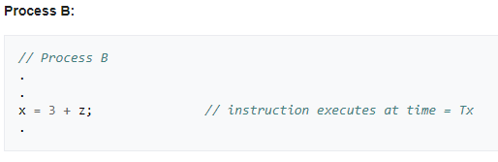
Need of critical section
Process A have to read variable ‘x’ and process B has to write to the same variable ‘x’ at the same time
if A needs to read the updated value of ‘x’, executing Process A and Process B at the same time may not give required results. To prevent this, variable ‘x’ is protected by a critical section. First, B gets the access to the section. Once B finishes writing the value, A gets the access to the critical section and variable ‘x’ can be read.

Slide 11
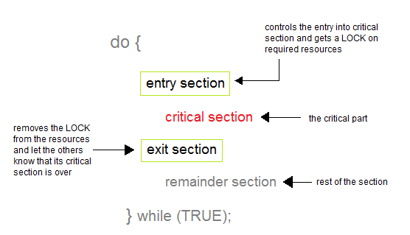
Solution to critical section
Brute-Force approach by using locking mechanism
Figure :2 [image source google ]

Slide 12
To critical section (Continued)
(i) Mutual Exclusion: Out of a group of cooperating processes, only one process can be in its critical section at a given point of time.
(ii) Progress: If no process is in its critical section, and if one or more threads want to execute their critical section then any one of these threads must be allowed to get into its critical section.
(iii) Bounded Waiting: After a process makes a request for getting into its critical section, there is a limit for how many other processes can get into their critical section, before this process's request is granted. So after the limit is reached, system must grant the process permission to get into its critical section.

Slide 13
Solution to synchronization problem
There are some mechanisms have been introduced for synchronization problem which are as follows-
(i) Hardware solution
(ii) Software solution
(iii) Strict alteration

Slide 14
Solution to synchronization problem(Cont.…)
Hardware Approach to synchronization problem:-
(i) Exclusive access to memory location always assumed
(ii) Test-and-Set: special machine-level instruction
(iii) Swap: atomically swaps contents of two words
' .

Slide 15
Solution to synchronization problem(Cont.…)
Test-and-Set Instruction
(i) hardware assistance for process synchronization .
(ii) a special hardware instruction that does two operations atomically . i.e., both operations are executed or neither is
(a) sets the result to current value
(b) changes current value to true
(c) when describing machine language (CPU) operations, the verb 'set' means 'set to true' .

Slide 16
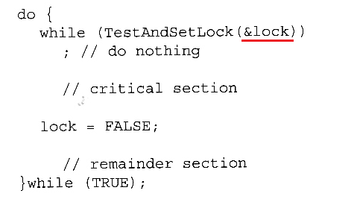
Solution to synchronization problem(Cont.…)
Test-and-Set Instruction (Cont.)
Figure :3 [image source google ]

Slide 17
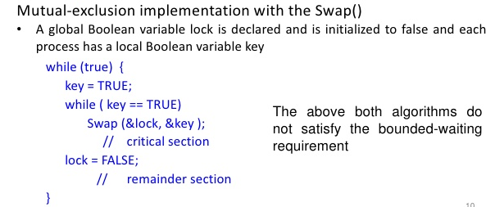
Solution to synchronization problem(Cont.…)
Figure :3 [image source google ]

Slide 18
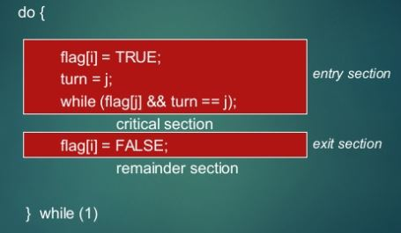
Solution to synchronization problem(Contd…)
Software Approach to synchronization problem(Peterson’s Solution):-
It is a two process solution.
We must assume that LOAD and STORE instructions are atomic and can not be interrupted in between.
The two processes will share two variables
(i)int turn :- is used to indicate that whose turn is there to enter in critical section.(ii)Boolean interested[2]:- is used to indicate whether a process is ready to enter in critical section the interested[i] = true {means Pi is ready}
Figure :4 [image source google ]

Slide 19
solution to synchronization problem(Cont.…)
Hardware Approach to synchronization problem(Peterson’s Solution):-
Exit section(process)
{
6. interested[process] == False;
}
CS
Entry section(process)
{
1. int other;
2. other = 1- process;
3. interested [ process] = TRUE;
4. turn = process
5. while (interested[other]==TRUE && turn == process);
}

Slide 20
solution to synchronization problem(Cont.…)
Analysis:-
(i) Mutual Exclusion is assured as only one process can access the critical section at any time.
(ii) Progress is also assured, as a process outside the critical section does not block other processes from entering the critical section.
(iii) Bounded Waiting is preserved as every process gets a fair chance.
Disadvantages:-
(i) It involves Busy waiting.
(ii) It is limited to 2 processes.

Slide 21
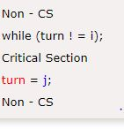
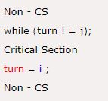
solution to synchronization problem(Cont.…)
Strict Alteration:-
Turn Variable or Strict Alternation Approach is the software mechanism implemented at user mode. It is a busy waiting solution which can be implemented only
for two processes. In this approach,
A turn variable is used which is actually
This approach can only be used for only two processes. In general, let the two processes be Pi and Pj. They share a variable called turn variable. The pseudo code of the program can be given as following.
Figure :6[image source google ]

Slide 22
PRODUCER AND CONSUMER PROBLEM
It is multi-process synchronization problem.
It is also known as bounded buffer problem.
This problem describes two processes producer and consumer, who share
common, fixed size buffer.
• Producer process will Produce some data item and put it into buffer.
• Consumer process will consume this data item (remove it from the buffer).
Condition for inconsistency:-
a) Producer must not try to produce any data item to buffer if buffer size is full.
b) Consumer must not try to consume any data item if buffer is empty.

Slide 23
PRODUCER AND CONSUMER PROBLEM
Solution for Producer:-
a) Producer either go to sleep or discard data if the buffer is full.
b) Once the consumer removes an item from the buffer, it notifies
the producer to put the data into buffer. (by using some synchronization tool)

Slide 24
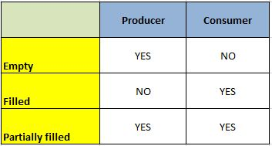
PRODUCER AND CONSUMER PROBLEM
Solution for Consumer:-
a) Consumer can go to sleep if the buffer is empty.
b) Once the producer puts data into buffer, it notifies the consumer
to remove (use) data item from buffer. (By using some synchronization tool)
Figure :7[image source google ]

Slide 25
SEMAPHORE
Semaphores are integer variables that are used to solve the critical section problem by using two atomic operations, wait() and signal() that are used for process synchronization.
The definitions of wait() and signal() are as follows
Wait:-The wait operation decrements the value of its argument S, if it is positive. If S is negative or zero, then no operation is performed.
wait(S)
{
while (S<=0);
S--;
}

Slide 26
SEMAPHORE
Signal:- The signal operation increments the value of its argument S.
signal(S)
{ S++;
}
Types of Semaphores:-
There are two main types of semaphores i.e. counting semaphores and binary semaphores. these are given as follows

Slide 27
Semaphore
Counting Semaphores:- These are integer value semaphores and have an unrestricted value domain. These semaphores are used to coordinate the resource access, where the semaphore count is the number of available resources. If the resources are added, semaphore count automatically incremented and if the resources are removed, the count I decremented.
Binary Semaphores:- The binary semaphores are like counting semaphores but their value is restricted to 0 and 1. The wait operation only works when the semaphore is 1 and the signal operation succeeds when semaphore is 0. It is sometimes easier to implement binary semaphores than counting semaphores.

Slide 28
Monitor
?
A more elevated level synchronization primitive.
A monitor is a bunch of techniques, variables, and information structures that are completely assembled in an exceptional sort of module or bundle.
Procedures may call the strategies in a monitor at whatever point they need to, however, they can't directly get to the monitor's interior data structures from methodology announced outside the monitor.
Monitor have a significant property for accomplishing common rejection: just one procedure can be dynamic in a monitor at any moment.

Slide 29
At the point when a procedure calls a monitor technique, the initial hardly any directions of the method will verify whether some other procedure is as of now dynamic inside the monitor .
Assuming this is the case, the calling procedure will be suspended until the different procedure has left the monitor. On the off chance that no different procedure is utilizing the monitor, the calling procedure may enter.

Slide 30
Producer consumer problem using monitor
The arrangement proposes condition factors, alongside two procedures on them, wait and signal.
At the point when a monitor method finds that it can't proceed (e.g., the maker finds the buffer full), it does a lookout for some condition variable, full.
This activity causes the calling procedure to block. It additionally permits another procedure that had been recently block from entering the screen to enter now.

Slide 31
Producer consumer problem using monitor
This different procedure the customer, can awaken its dozing accomplice by doing a sign on the condition variable that its accomplice is looking out for.
To abstain from having two dynamic procedures in the monitor simultaneously a sign explanation may show up just as the last proclamation in a monitor method.
On the off chance that a sign is done on a condition variable on which a few procedures are pausing, just one of them, controlled by the framework scheduler, is retrieve.

Slide 32
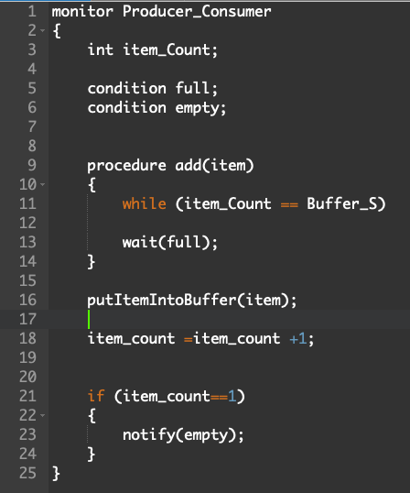
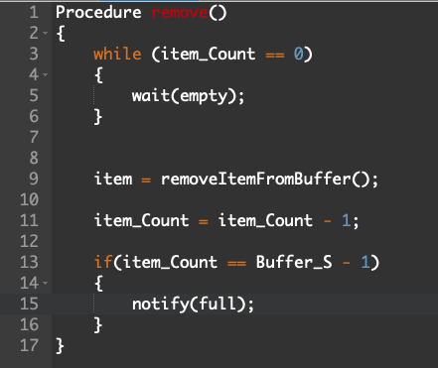
Producer consumer problem using monitor
Figure :9
Figure :8

Slide 33
Reader’s & Writer Problem
Reader’s writer problem is a one of the example of a classic synchronization problem.
Consider below situation when resource shared between number of people.
If one user is accessing the file so at the same time no other user can read and write that same file. Otherwise change will not reflects.
However different users can read same file simultaneously.

Slide 34
Reader’s & Writer Problem
This situation consider as reader’s and writer’s problem
Lets take a look into problem statement more.
Two operation we consider here one is Read operation and another is write operation.
We have two user consider here one is reader and another one is writer.
If one reader is using file and one writer come to access that same file is a problem (R + W = Problem)
If one writer is using file and one reader come to to access same file is a problem (W + R = Problem)

Slide 35
Reader’s & Writer Problem
If one writer is using file and another write come to access same file is a problem. (W + W = Problem)
If one reader is using file and another reader come to access same file so no problem (R + R = No problem).
This four case we have to consider.
Here we use semaphore because here synchronization requires to take care of given cases.

Slide 36
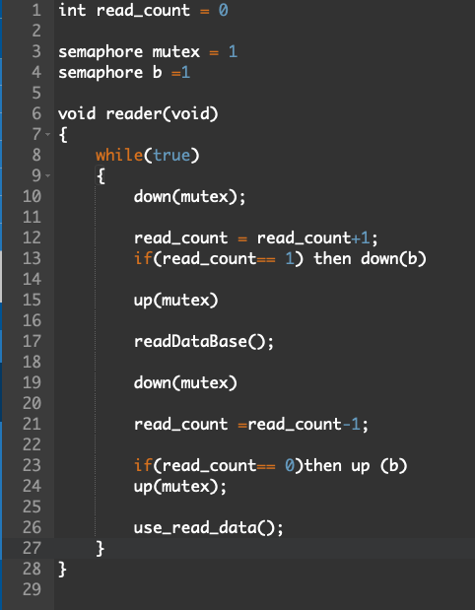
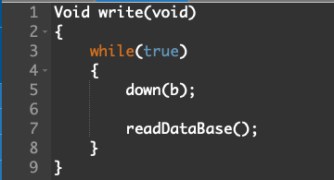
Reader’s & Writer Problem
Figure :11
Figure :10

Slide 37
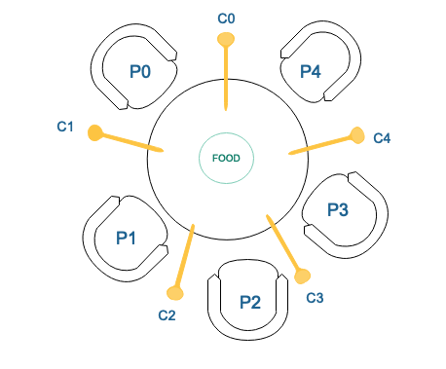
Dining Philosopher’s Problem
As we take a look in given figure five philosopher ( P0,P1,P2,P3,P4) seating on dining table and given chopsticks (C0,C1,C2,C3,C4) to eat food on table .each philosopher requires tow chopsticks at a same time to eat food
At any instant, a philosopher is either eating or thinking. If philosopher is eating have to pick chopstick one from their left and one from their right.
If philosopher is thinking it down the chopstick on table.
Figure :12 dining philosopher’s problem [1]

Slide 38
Dining Philosopher’s Problem
For example philosopher P0 want to eat food it require two chop stick C0 and C1 as consider to below here i = 0 for p0 as 0th position.
take_chopstick(i); = C0
take_chopstick((i+1) % N); =(0+1)mod5 = C1

Slide 39
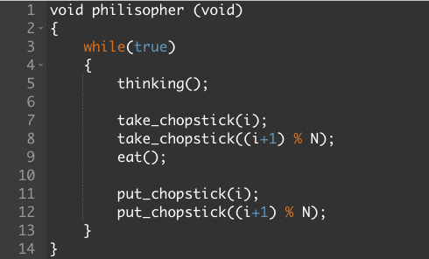
Dining Philosopher’s Problem
Now discuss case 1: In which one by one philosopher is eating and
thinking . which is best case. So if philosopher P0 is eating with chopstick C0 & C1 then put the chopstick and then other P1 philosopher is come to eat which require chopstick C1 and C2 .as we see chopstick is now available for philosopher P1 because philosopher P0 already put down chopstick C1 after eating. So in this case no problem occur
Figure :13

Slide 40
Dining Philosopher’s Problem
Now lets discuss Case 2: In which if philosopher P0 is eating with chopstick C0 & C1 and at the same time philosopher P1 enter to eat so it require chopstick C1 & C2 . Now in this case C1 chopstick not available for Philosopher P1 because it taken by philosopher P0 already.
To deal with is situation Binary semaphore use
When one philosopher eat the food with needed chopstick and case 2 situation occur it block that philosopher. otherwise it allow another philosopher if its require chopstick available on table so at some time multiple philosopher come and eat and put chopstick if their required chopstick available on the table .

Slide 41
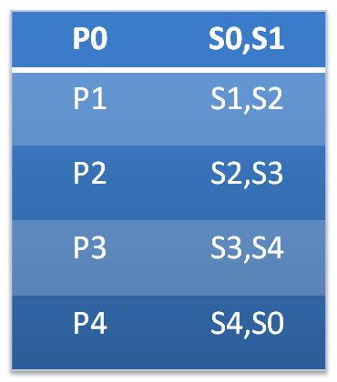
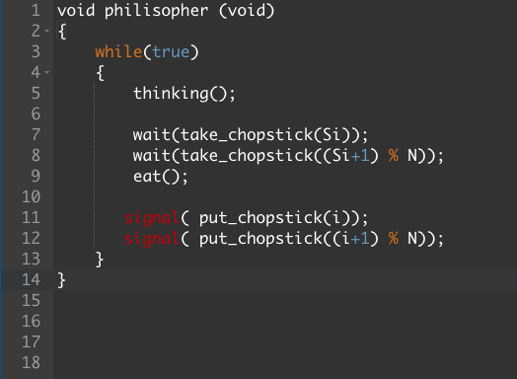
Dining Philosopher’s Problem
Consider this given table in this it shows which semaphore require by each philosophers.
Table:1
Figure :14

Slide 42
Dining Philosopher’s Problem
Lets consider now at starting condition all semaphore are 1.
Now if Philosopher P0 is using S0 and S1 semaphore at present so it become 0 Until Philosopher put it down . So another philosopher who want to use common semaphore not allow at time.
Consider case 3: If all five philosopher comes at time and pick their first semaphore (S0,S1,S2,S3,S4) shown in Table 3 so for all philosopher second semaphore for will not available.
S0 | S1 | S2 | S3 | S4
1 | 1 | 1 | 1 | 1
0 0
Table:2

Slide 43
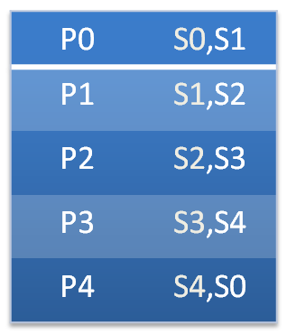
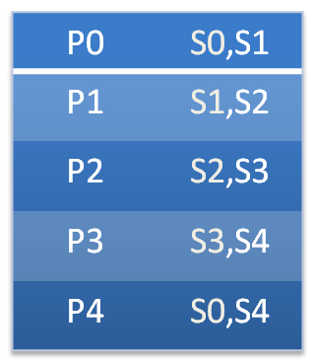
Dining Philosopher’s Problem
This situation consider as a deadlock. To avoid this situation philosopher P4 need to swipe their semaphore as below Table 4. So when P4 comes it will not allow Due to not availability of their first semaphore. So S4 will remain 1 and P3 will use S4 & S3 for eat and put it back. So again S3 & S4 will available as show in Table 6 so further that P2 will use S2 & S3 and run further process .
Table:3
Table:4
S0 | S1 | S2 | S3 | S4
0 | 0 | 0 | 0 | 1
Table:5
S0 | S1 | S2 | S3 | S4
0 | 0 | 0 | 1 | 1
Table:6
S0 | S1 | S2 | S3 | S4
0 | 0 | 1 | 1 | 1
Table:7

Slide 44
Reference
[1] https://www.geeksforgeeks.org/dining-philosopher-problem-using-semaphores/

Slide 45


www.paruluniversity.ac.in

